Slide 1
History of Computers
Overview

Slide 2
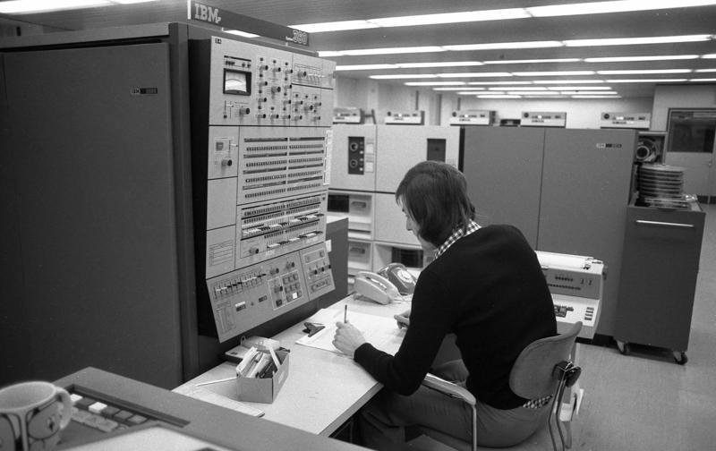
Mainframe Computers (1950 to Present)
Used by large businesses, banks, government, and research institutions
Housed in several rooms or dedicated building
For cutting edge
Processing Speed
Memory Storage Capacity

Slide 3
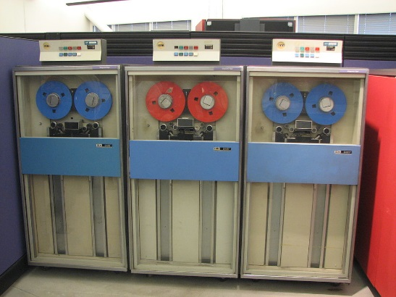
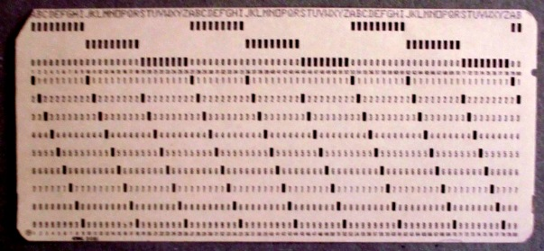
Mainframe Computers (1950 to Present)
IBM 360
Introduced in 1964
64Kb Main Memory
Magnetic Tape for external storage
Programmed using Punch Cards
20 KIPS Speed (i.e. 20,000)
Cost: $2,500,000

Slide 4
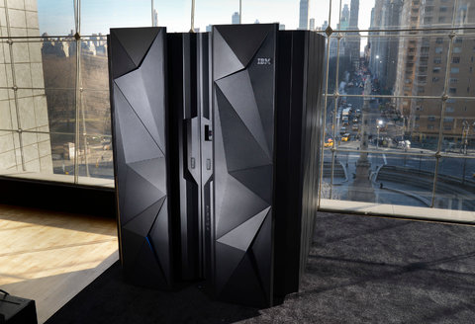
Mainframe Computers (1950 to Present)
IBM z13
Introduced in 2015
Refrigerator Sized
GigaByte Main Memory
TeraByte Hard Disks and Cloud Storage
Programmed using WIFI connected PCs
52 BIPS Speed (i.e. 52,000,000,000)
Mobile Friendly!
Cost: $250,000

Slide 5
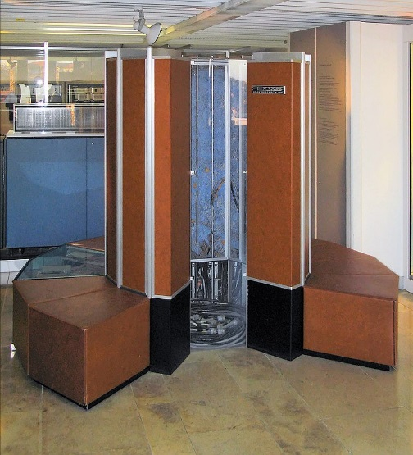
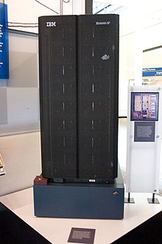
Super Computers
Used by military, security, and scientific organizations
Cray-1 (1976)
Vector Processor
160 FLOPS
Small main memory with extremely fast input / output
Cost $9,000,000
IBM Deep Blue (1995)
Parallel Processor
Special Purpose Design
Became World Chess Champion
Won Jeopardy! TV Game

Slide 6
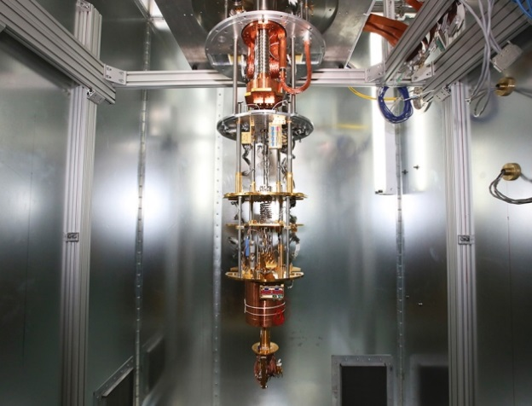
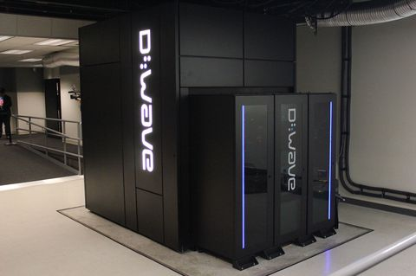
Quantum Computers
Next Generation Technology
Used by military, security, and scientific organizations
Uses Q-Bits
True, False, Maybe (probability)
Speed
Theoretically unlimited
Memory
Theoretically Unlimited
D-Wave Systems
Vancouver, BC
https://www.youtube.com/watch?v=ex0uNEIYrug

Slide 7
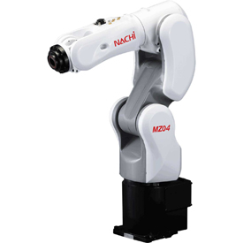
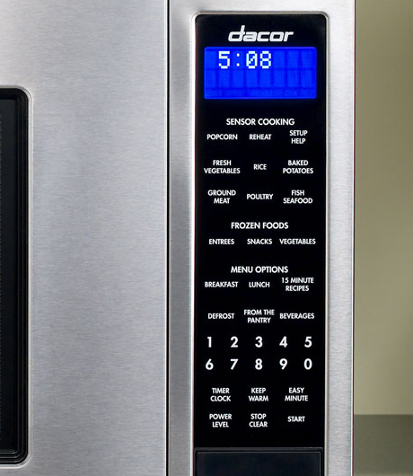
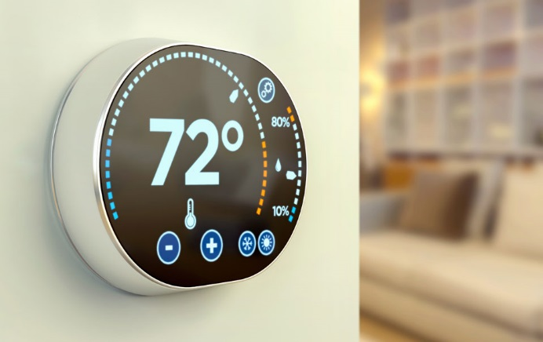
Embedded Computers
Embedded Computers are Everywhere!
Industrial Applications
Traditional Market
Home & Consumer Products
Rapidly growing applications

Slide 8
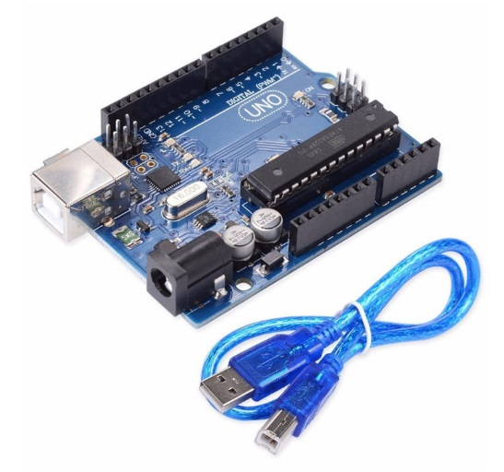
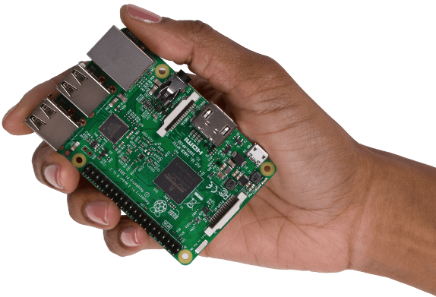
Embedded Computers
Microcontroller Computers
Small Size / Full Functionality
Limited Speed
Limited Memory
Low Cost ($5)
Common Examples
Arduino
Raspberry Pi

